Slide 1
Topic: Similar Triangles Problems Eq: How can we apply our knowledge of similar triangles?
Year 9

Slide 2
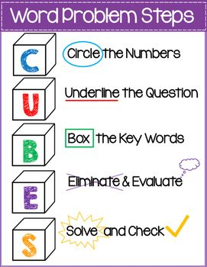
24
7
30
Similar Triangles Problems
Date
EQ – How can we apply our knowledge of similar triangles?
Step 1. Read the question carefully.
Solving Word Problems
Step 2. Draw a picture
Step 3. Write all known angle sizes and lengths onto the triangle
Step 4. Find corresponding sides to find the scale factor.
Step 5. Use your scale factor to find any missing sides .

Slide 3



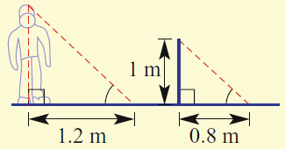


24
7
30
Similar Triangles Problems
Date
EQ – How can we apply our knowledge of similar triangles?
Step 1
Step 2
Step 3
Step 1. Read the question carefully.
Step 2. Draw a picture
Step 4
Step 3. Write all known angle sizes and lengths onto the triangle
Step 4. Find corresponding sides to find the scale factor.
Step 5
Step 5. Use your scale factor to find any missing sides .

Slide 4
You have 3 minutes to write a summary that answers the Essential Question.
Be prepared to share your summary with the people sitting in your row.
Write your summary

Slide 5

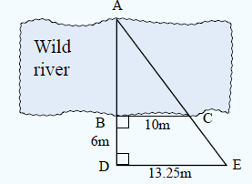
Step 1. Read the question carefully.
We do
Step 2. Draw a picture
Step 3. Write all known angle sizes and lengths onto the triangle
Step 4. Find corresponding sides to find the scale factor.
Step 5. Use your scale factor to find any missing sides .

Slide 6

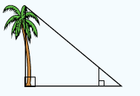
Step 1. Read the question carefully.
We do
Step 2. Draw a picture
Step 3. Write all known angle sizes and lengths onto the triangle
Step 4. Find corresponding sides to find the scale factor.
Step 5. Use your scale factor to find any missing sides .

Slide 7
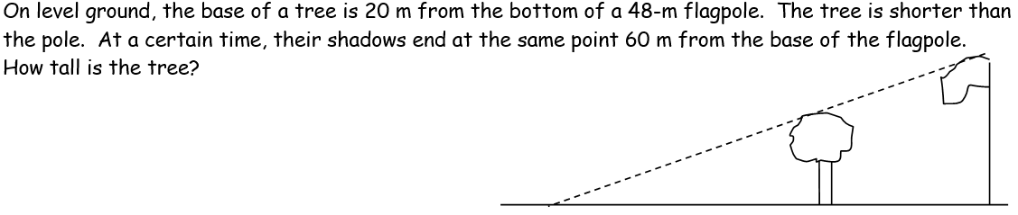
Step 1. Read the question carefully.
You do
Step 2. Draw a picture
Step 3. Write all known angle sizes and lengths onto the triangle
Step 4. Find corresponding sides to find the scale factor.
Step 5. Use your scale factor to find any missing sides .

Slide 8
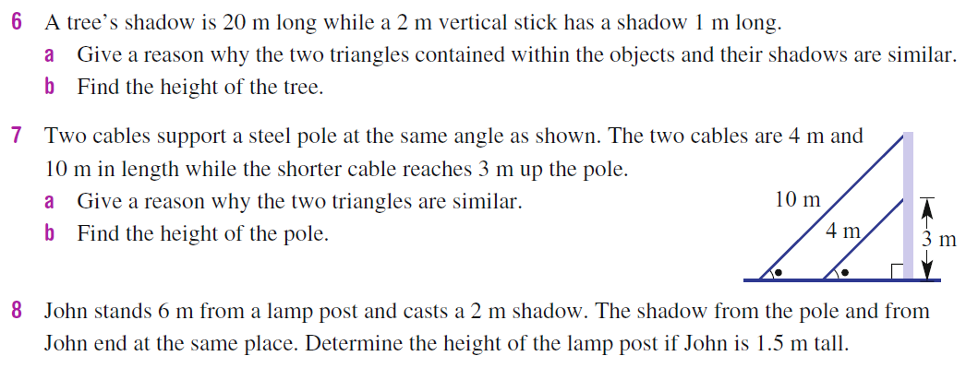
You do

Slide 9
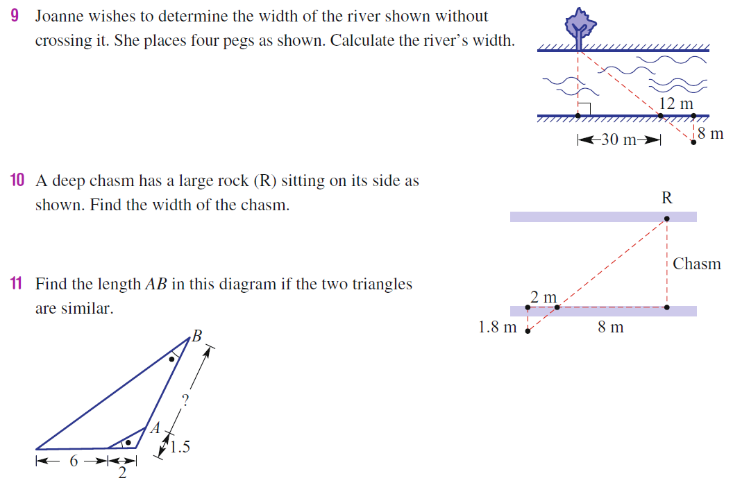
You do - Extension

